Slide 1
Distributed Systems
International Institute of Information Technology
Hyderabad, India
Pictures not cited explicitly are taken from the course book or wikepedia.

Slide 2
Course Policies
Textbook(s)
  Distributed Computing: Principles, Algorithms, and Systems: Kshemkalyani and Singhal.
  Distributed Algorithms: Gerald Tel, Nancy Lynch
Grading policy – Almost Final!
Slip Tests(~7): 15
Project:20
Assignments(3) : 20: 2 coding and one theory
1 Quiz + Midsem + Endsem: (10+12)+23=45

Slide 3
Syllabus (Tentative)
Module 1
  Introduction
  Time and Synchronization
  Mutual Exclusion
  Deadlock Detection
Module 2
  Distributed graph algorithms
  Consensus, Agreement, Locking
  Deadlock Handling
  Distributed File systems

Slide 4
Syllabus (Tentative)
Module 4
  Limitations of distributed computing
  Self-Stabilization
  CAP Theorem
  Block Chain and BitCoins (Guest lecture)

Slide 5
TAs
Ramaguru Guru
Kannav Mehta
Akshit Garg
Snehal Kumar
Sahiti Reddy
Prince Varshney
Nikunj Nawal
Lokesh V

Slide 6
Motivation
A group of computers working together as to appear as a single computer to the end-user.– Tannenbaum
Eg: Airline reservation, Online Banking
Required Features:
Lot of computers
Perform Concurrently
Fail independently
Dont share a global clock
Why Distributed Systems?
Best hardware may be insufficient to scale vertically (upgrade hardware of a system) hence the need to scale horizontally. Other benefits: Fault tolerance and low latency.

Slide 7
Data Structures Week 1
Motivation
Horizontal Scaling to fit data, shift data to manage load – scalability
There is a limitation to how much you can upgrade a machine. Every machine has its threshold for
RAM, storage, and processing power.
Inherently distributed. Ex: Banking system across cities
Data Sharing. Ex Libraries, certain files, Complete datasets
Enhanced Reliability
Increased Performance/cost ratio (parallelistion)
Fault Tolerance

Slide 8
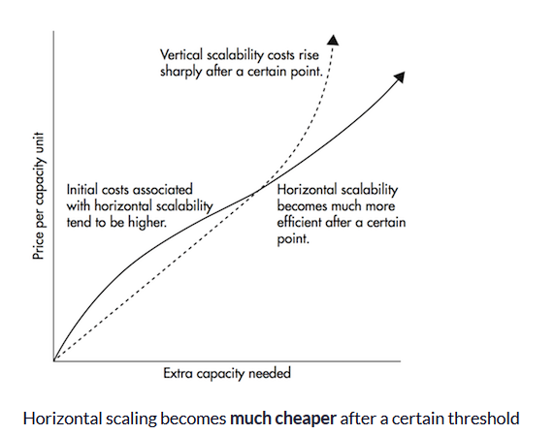
Data Structures Week 1

Slide 9
Challenges with a Distributed System
Data Structures Week 1
Unreliable communication – messages may drop, could be intercepted, could be delayed, could be out of order.
Lack of global knowledge – a participating node has information of only his local memory and local computations. (no shared memory)
Lack of synchronisation (different local clocks)-how to implement sequence in which we want things to happen; how to order steps across participating nodes where each node has a different clock
Concurrency control – Data distributed across nodes. Moreover each has its own clock. How do you implement Mutual exclusion now or critical sections now?
Failure and recovery : Nodes may fail, communication channels may fail – how do you still make sure the system functions. When a node recovers how do you make the updates on it.
Deadlocks, Termination Detection, File systems are other concerns

Slide 10
Data Structures Week 1
Can we solve these -
The village without a mirror – consensus
War Preparation with messengers
Consensu
  Consensus: All non-faulty processes must agree on a common value.
      If initial value of all non-faulty processes is v, then the agreed upon value must be v
Consensus with traitors included - the general too may be malicious (Byzantine Agreement Problem)

Slide 11
Data Structures Week 1
Time in Distributed Systems

Slide 12
Data Structures Week 1
Time in Distributed Systems
Recall the quartz oscillation based clock ticks used in digital systems.
  These clocks drift.
With such a drift, it is not possible to arrange events according to a causal order.

Slide 13
Why is time important
Data Structures Week 1
to determining the order in which events occur
helps maintain consistency in replicated databases,
helps design correct deadlock detection algorithms to avoid phantom and undetected deadlocks.
Tracking of dependent events
In debugging, it helps construct a consistent state
for resuming reexecution; in failure recovery, it helps build a checkpoint;
in replicated databases,
it aids in the detection of file inconsistencies in case of a network partitioning

Slide 14
Motivation
  To ensure a correct and consistent view of a distributed database.
  Sensor networks and sensing properties of the physical world.
  Applications using time-outs to deduce certain actions/events.

Slide 15
Physical Time and Synchronization
In centralized systems, there is only single clock. A process gets the time by simply issuing a system call to the kernel.
  The time returned by the kernel is the “time”.
In distributed systems, there is no global clock or common memory. Each processor has its own internal clock and its own notion of time.
These clocks can easily drift seconds per day, accumulating significant errors over time.
This clearly poses serious problems to applications that depend on a synchronized notion of time.

Slide 16
Cristian’s (Time Server) Algorithm
Uses a time server to synchronize clocks
  Time server keeps the reference time (say UTC)
  A client asks the time server for time, the server responds with its current time, and the client uses the received value T to set its clock
But network round-trip time introduces errors…
  Let RTT = response-received-time – request-sent-time (measurable at client),
  If we know (a) min = minimum client-server one-way transmission time and (b) that the server timestamped the message at the last possible instant before sending it back
  Then, the actual time could be between [T+min,T+RTT— min]
  where RTT-min is the max time it took for the response to return which happens when request took min time to go

Slide 17
Berkeley UNIX algorithm
One master machine and set of slave nodes
Periodically, this daemon polls and asks all the machines for their time
The machines respond.
The daemon computes an average time and then broadcasts this average time.
The algorithm assumes that each machine node in the network either doesn’t have an accurate time source or doesn’t possess an UTC server.

Slide 18
Decentralized Averaging Algorithm
Each machine has a daemon without UTC
Periodically, at fixed agreed-upon times, each machine broadcasts its local time.
Each of them calculates the average time by averaging all the received local times.

Slide 19
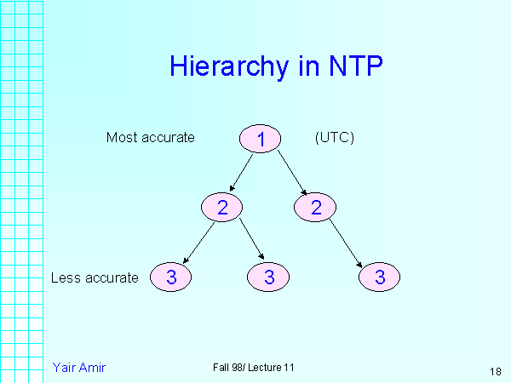
Network Time Protocol (NTP)
Most widely used physical clock synchronization protocol on the Internet
10-20 million NTP servers and clients in the Internet
Claimed Accuracy (Varies)
  milliseconds on WANs, submilliseconds on LANs
Hierarchical tree of time servers.
  The primary server at the root synchronizes with the UTC.
  Secondary servers - backup to primary server.
  Lowest
    synchronization subnet with clients.

Slide 20
Data Structures Week 1
However even with NTP, physical time cannot be perfectly synchronised. Moreover different nodes might have different NTP servers they are talking to as well.
But, do we really need to know the physical time or do we only need to know the sequence of events and that too among dependent events?

Slide 21
Modeling Distributed Systems
Can think of a distributed system as a collection of processors, and
A communication network.
The processors
  May fail
  Share no global memory
We also assume that the network
  Has delays that are finite but unpredictable.
  May not respect message ordering
  Can lose messages, duplicate messages
  May have links that become unavailable/may fail.

Slide 22
A Distributed Program
distributed program is
  A set of n processes, P₁, P₂, …, P_{n}, typically each running on a different processor.
  A set of channels C_{ij} that connects Processor i to Processor j.
The state of a process P_{i} includes
  The local memory of P_{i}
  Also depends on messages sent, and received
  The state of a channel C_{ij} includes
  The messages in transit on this channel.

Slide 23
Types of events
We will assume that processor sending a message does not wait for its delivery.
Any distributed program has three types of events
  Local actions
  Message Send
  Message Receive
Can then view a distributed program as a sequential execution of the above events.

Slide 24
Logical Time
Data Structures Week 1
Logical time is a notion we introduce to order events. It provides a mechanism to define the causal order in which events occur at different processes. The ordering is based on the following:
Two events occurring at the same process happen in the order in which they are observed by the process.
If a message is sent from one process to another, the sending of the message happened before the receiving of the message.
If e occurred before e' and e' occurred before e" then e occurred before e".

Slide 25
Causality between events
Think of events happening at a process P_{i}.
One can order these events sequentially,
In other words, place a linear order on these events.
Let h_{i} = {e¹_{i}, e²_{i}, …}, be the events at process P_{i}.
A linear order H_{i} is a binary relation →_{i} on the events h_{i} such that e^{k}_{i} →_{i} e^{j}_{i} if and only if the event e^{k}_{i} occurs before the event e^{j}_{i} at Process Pi.
The dependencies captured by →_{i} are often called as causal dependencies among the events h_{i} at P_{i}.

Slide 26
Causality for msgs
What about events generated due to messages?
Consider a binary relation →_{msg} across messages exchanged.
Clearly, for any message m, send(m) →_{msg} recv(m).
These two relations →_{i} and →_{msg} allow us to view the execution of a distributed program

Slide 27
Causality Definition
One can now view the execution of a distributed program as a collection of events.
Consider the set of events H = U_{i} h_{i}, where h_{i} is the events that occurred at process P_{i}.
Define a binary relation → expressing causality among pairs of events that possibly occur at different processes. → defined as:
e^{x}_{i} → e^{y}_{j} iff
{
i = j and x < y, or
e^{x}_{i} →_{msg} e^{y}_{j}, or
There exists e^{z}_{k} in H s.t. e^{x}_{i} → e^{z}_{k} and e^{z}_{k} → e^{y}_{j}

Slide 28
Logical vs. Physical Concurrency
Two events are logically concurrent if and only if the events do not causally affect each other. In other words, e_{i} || e_{j} ↔ Not(e_{i} → e_{j}) and Not(e_{j} → e_{i}).
Note that for logical concurrency of two events, the events may not occur at the same time.
On the other hand, we define that two events are physically concurrent iff the events occur at the same physical time.

Slide 29
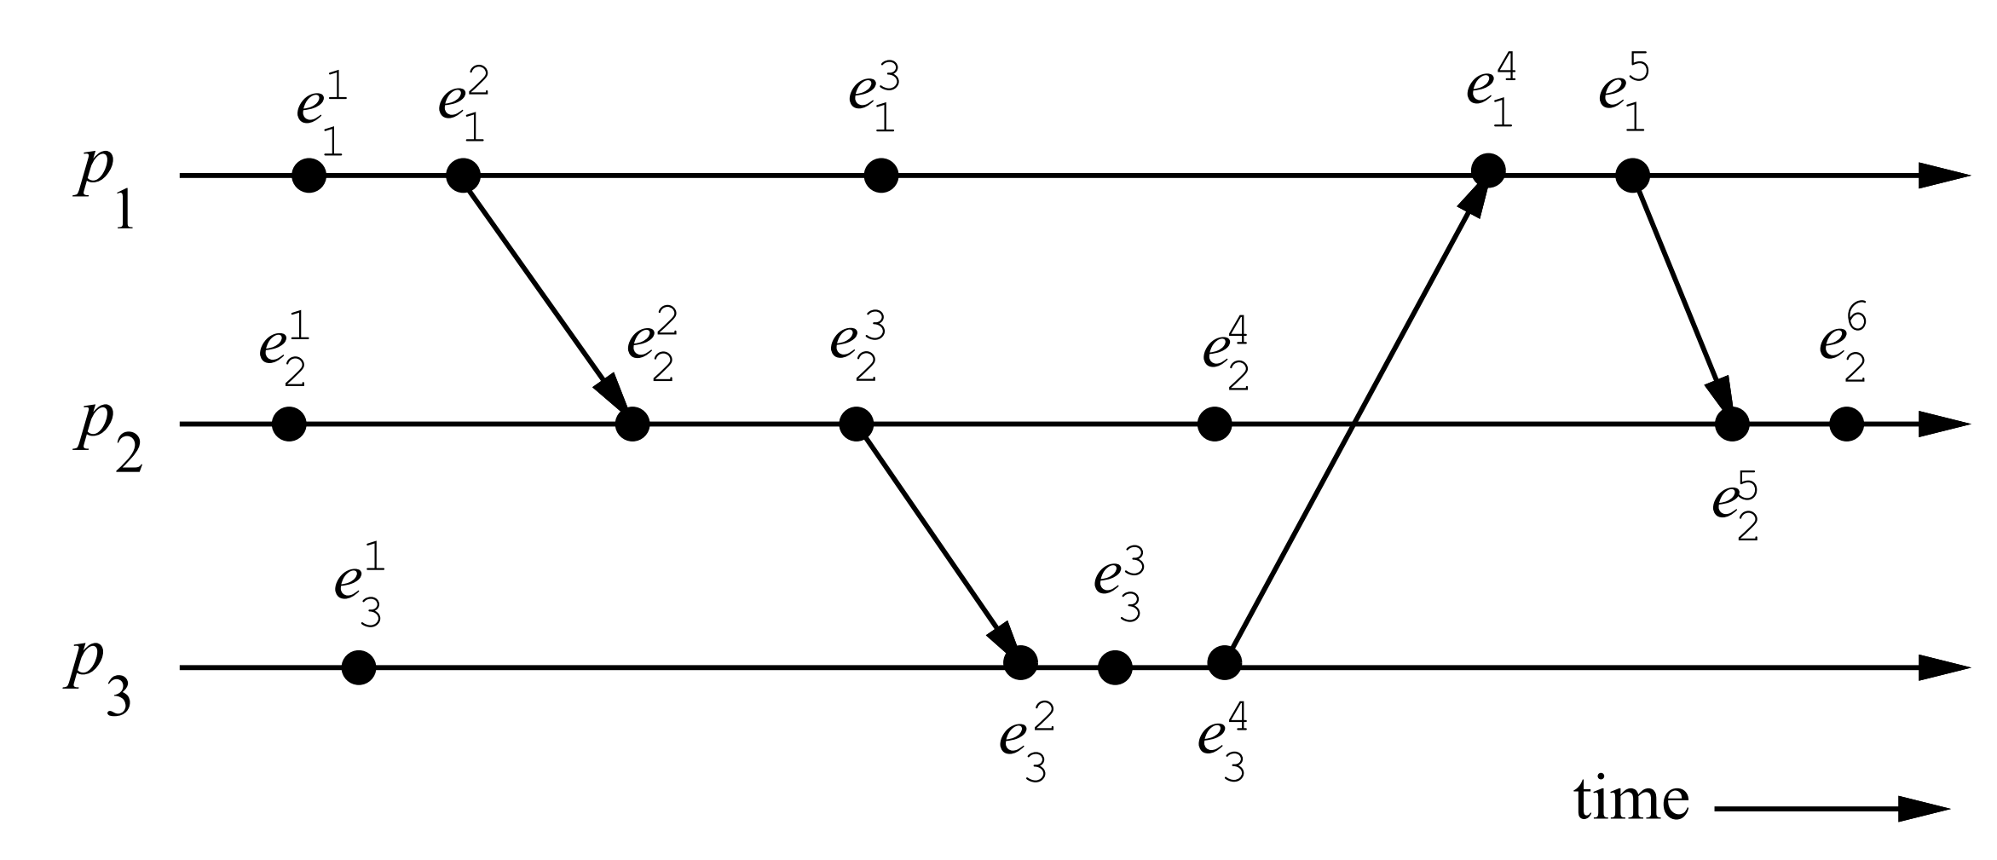
A Distributed Program in Execution
Examples – Find concurrent events, Find some non-trivial (across P_{i}s) precedence among events.

Slide 30
A Distributed Program in Execution
.
Concurrent: e¹₃ and e³₁ ? e⁴₂ and e¹_{3 ?}
Causal: e³₃ → e⁵₁, e²₁ → e³₂, e⁴₃ → e⁵_{1 ?}

Slide 31
Data Structures Week 1
Logical Time
Armed with our notation of events and precedences amongst events, we now study logical time.
We now see how logical time can be maintained in a distributed system.
Three ways to implement logical time -
  scalar time,
  vector time, and
  matrix time
scalar time,
vector time, and
matrix time

Slide 32
Logical Time
Data Structures Week 1
The logical clock C is a function that maps an event e in a distributed system to an element in the time domain T, denoted as C(e) and called the timestamp of e, and is defined as follows:
C : H → T
such that for two events e_{i} and e_{j} , e_{i} → e_{j} ⇒ C(e_{i}) < C(e_{j}).
Elements of T form a partially ordered or totally ordered set over a relation < ?

Slide 33
Logical Time
Data Structures Week 1
Consistent: When T and C satisfy the condition: for two events e_{i} and e_{j} , e_{i} → e_{j} ⇒ C(e_{i}) < C(e_{j}).
This property is called the clock consistency condition.
Strongly Consistent: When T and C satisfy the condition:
for two events e_{i} and e_{j} , e_{i} → e_{j} ⇔ C(e_{i}) < C(e_{j}).
then the system of clocks is said to be strongly consistent.

Slide 34
Logical Time
Data Structures Week 1
Each processor needs some data structure to represent logical time.
  A local logical clock, denoted by lc_{i}, that helps process p_{i} measure its own progress.
  A logical global clock, denoted by gc_{i}, that is a representation of process p_{i}’s local view of the logical global time.
    Allows p_{i} to assign consistent time stamps to its local events.
    Typically, lc_{i} is a part of gc_{i}.
Each processor needs a protocol to update the data structures to ensure the consistency condition.

Slide 35
Logical Time
Data Structures Week 1
Each processor needs a protocol to update the data structures to ensure the consistency condition.
  Rule 1: Specify how the local logical clock is updated by a process when it executes an event.
  Rule 2: Specify how a process updates its logical global clock to update its view of the global time and global progress
all logical clocks systems implement Rule1 and Rule2

Slide 36
Scalar Time
Data Structures Week 1
Proposed by Lamport in 1978
  Lamport won the 2013 Turing award for “contributions to the theory and practice of distributed and concurrent systems, notably the invention of concepts such as causality and logical clocks, .....”.
Time domain is the set of non-negative integers.
The logical local clock of a process p_{i} and its local view of the global time are combined into one integer variable C_{i}.

Slide 37
Scalar Time
Data Structures Week 1
Data structure: The logical local clock of a process p_{i} and its local view of the global time are squashed into one integer variable C_{i}.
Rule1: Before executing an event (send, receive, or internal), process p_{i} executes the following:
C_{i} := C_{i} + d (d > 0)
  Rule 2: Each message piggybacks the clock value of its sender at sending time. When a process p_{i} receives a message with timestamp C_{msg} , it executes the following actions:
    C_{i} := max(C_{i}, C_{msg} )
    Execute Rule1.
    Deliver the message.

Slide 38
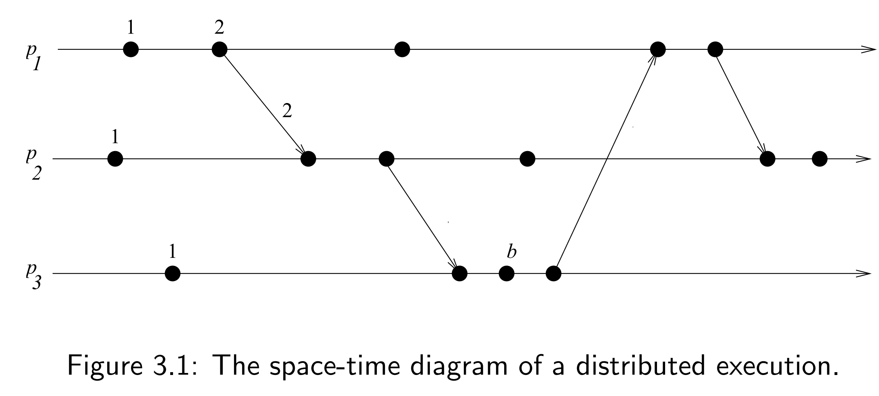
Scalar Time
Data Structures Week 1
Example. Use d = 1 and assign time stamps for the events.

Slide 39
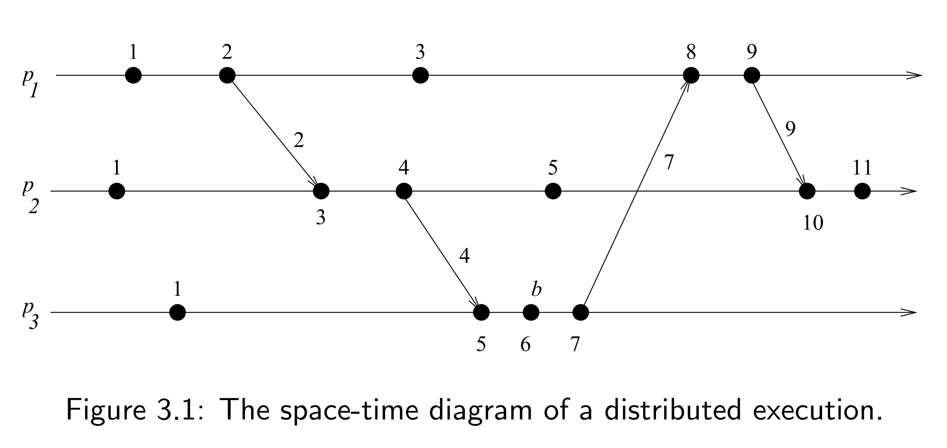
Scalar Time
Data Structures Week 1
Example

Slide 40
Scalar Time Properties
Data Structures Week 1
Monotonicity
  For two events e_{i} and e_{j} , e_{i} → e_{j} ⇒ C(e_{i}) < C(e_{j}).
Total Ordering: Can use the logical time given by the scalar clocks to induce a total order .
  Note that the timestamps alone do not induce a total order.
  Two events at different processors can have an identical timestamp.
  But the tuple (t, i) for each event with (t₁,i₁) < (t₂, i₂) if either t₁ < t₂ or ( (t₁ == t₂) and i₁<i₂) is a total order. In (t,i), t denotes timestamp and i the identiy of the process.
  This total order is consistent with the relation →.
  Note: According to the total order above: For events e1 and e2, e1 < e2 ⇒ Either e1 → e2 or e1 || e2.

Slide 41
Scalar Time: Properties
Data Structures Week 1
Total Ordering: Tie breaking mechanism.Requests are timestamped and served according to the total order based on these timestamp
Consider the tuple (t, i) for each event where
t denotes timestamp and i the identiy of the process.
(t₁,i₁) < (t₂, i₂) if either t₁ < t₂ or ( (t₁ == t₂) and i₁<i₂) is a total order.
This total order is consistent with the relation →.
Note: According to the total order above: For events e1 and e2, e1 < e2 ⇒ Either e1 → e2 or e1 || e2.

Slide 42
Scalar Time
Data Structures Week 1
Event Counting:
Strong Consistency:
Sriram Murthy

Slide 43
Scalar Time
Data Structures Week 1
Event Counting: Set the increment d to 1 always.
If some event e has a timestamp t, then e is dependent on t – 1 other events to occur.
This can be called as the height of event e.
No Strong Consistency: Note that scalar time does not provide strong consistency. [Strong consistency requires that e_{i} → e_{j} ⇔ C(e_{i}) < C(e_{j}).]
  Example suffices. Refer to the timeline again.
Sriram Murthy

Slide 44
Scalar Time
Data Structures Week 1
No Strong Consistency: Consider third event of p₁ and p₂.

Slide 45
Scalar Time: Limitation
Data Structures Week 1
One of the limitations of scalar time is the lack of strong consistency.
Strong consistency not achieved as scalar time uses a single time that represents the logical local clock and the logical global clock.
  This means that the causality of events across processors is lost. That is, by looking at the times we can not make out which two events are casually related and which two are not.
  Vector time solves this problem but with big data structures.

